Slide 1

INSTITUTE UIE
DEPARTMENT ACADEMIC UNIT-1
Bachelor of Engineering (Computer Science & Engineering)
Subject Name Basic Electrical & Electronics Engineering
Subject Code 21ELH-101
Prepared By
AKHIL NIGAM
Unit-1 Chapter-1
Series RLC Circuit
Lecture No.5
DISCOVER . LEARN . EMPOWER

Slide 2
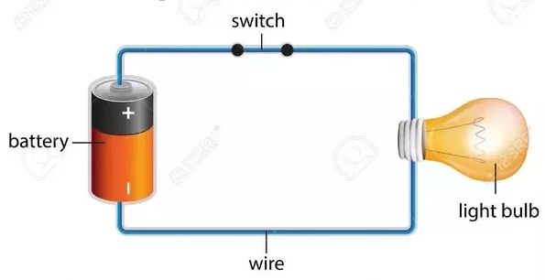
Lecture Objectives
S. No. | Objectives
1 | To make student aware about analysis of series RL circuit
2 | To aware about analysis of series RC circuit
3 | To provide knowledge about analysis of series RLC circuit
4 | To make familiar with importance of power factor in series RL, RC and RLC circuit
5 | To give brief knowledge about phasor diagram of series RL, RC and RLC circuit
https://www.quora.com/What-are-the-differences-between-a-circuit-and-an-electric-circuit

Slide 3
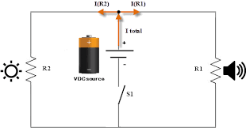
Course Objectives
S. No. | Objectives
1 | To meet students with basic knowledge of dc circuits, electromagnetism and ac fundamentals.
2 | To aware about introduction to single and three phase ac circuit with their construction and working principles.
3 | To provide knowledge about electrical and electronics engineering fundamentals.
4 | To acquire specific knowledge skills so as to comprehend how electric, magnetic and electronic circuits are applied in practice.
https://library.automationdirect.com/basic-electrical-theory/

Slide 4
Course Outcomes
CO Number | Title | Level
CO1 | Identify the different types of electrical elements and the basic op-amp circuit elements and to illustrate the various types of motors, transducers and batteries. | Remember
CO2 | Understand basic principles of transformers, transducers, op-amps, DC and AC motors and to compare the different methods for analyzing electrical and magnetic circuits. | Understand
CO3 | Derive the relationships between parameters in electric and magnetic circuits and motors and to determine specifications of op-amps. | Analyze
CO4 | Solve the basic problems related to electric circuits, magnetic circuits and motors and to assess the characteristics of different configurations of op-amps. | Evaluate
CO5 | Design the different applications of transducers, motors as well as the op-amps like adders, subtractor and comparators. | Create
https://library.automationdirect.com/basic-electrical-theory/

Slide 5
Importance of Basic Electrical & Electronics Engineering
Use from home appliances to industrial plants.
Usage in communication and satellite navigation system.
Handles in electronics equipment and computers.
Deals with the problem of power transmission and motor control.
Control and monitor the medical appliances in hospitals.
High voltage applications with heavy current.
Robotics applications.
Product designing and development.

Slide 6
Content
DC and AC Circuits:
Analysis of RL Circuit(Phasor Diagram , Impedance, Power and Current in RL Circuit)
Analysis of RC Circuit(Phasor Diagram , Impedance, Power
and Current in RC Circuit)
Analysis of RLC Circuit(Phasor Diagram , Impedance and
Power in RLC Circuit)

Slide 7
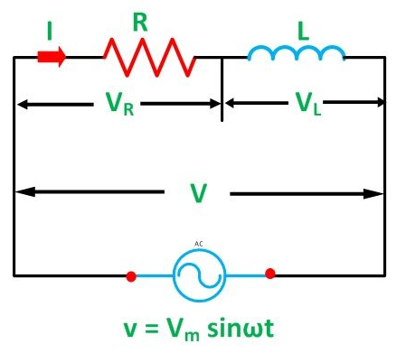
Series RL Circuit
In Series RL Circuit, resistor and inductor are connected in series, so current flowing through both the elements is same
i.e I_{R}=I_{L}=I.
We are using ac voltage V = Vm sinωt
V_{R} – voltage across the resistor R
V_{L} – voltage across the inductor L
V – Total voltage of the circuit
Fig.1 series RL circuit
https://circuitglobe.com/what-is-rl-series-circuit.html

Slide 8
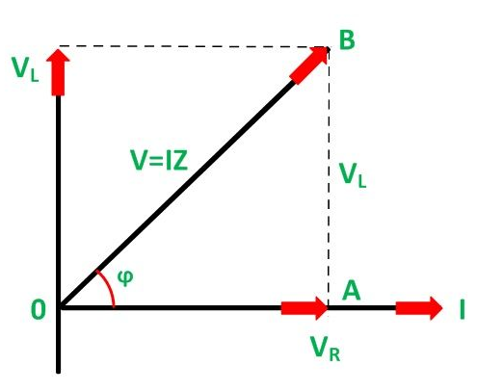
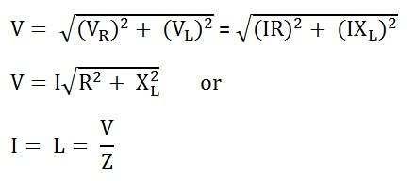

Phasor Diagram of Series RL Circuit
From the phasor diagram we can write
……….(1)
………………………….….(2)
………………………………….…….(3)
Fig.2 Phasor diagram of series RL circuit
https://circuitglobe.com/what-is-rl-series-circuit.html

Slide 9
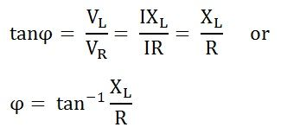

Phasor Diagram of Series RL Circuit
From the phasor diagram we can write phase angle such as:
……………..(4)
…………………………….(5)
Power Factor of the circuit will be
Contd. Fig.2 Phasor diagram of series RL circuit
https://circuitglobe.com/what-is-rl-series-circuit.html

Slide 10
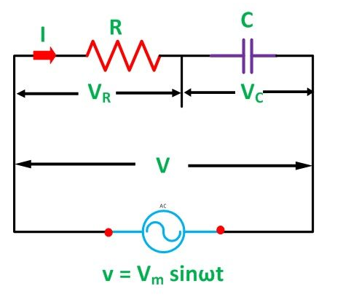
Series RC Circuit
In Series RC Circuit, resistor and capacitor are connected in series, so current flowing through both the elements is same
i.e I_{C}=I_{L}=I.
We are using ac voltage V = Vm sinωt
V_{R} – voltage across the resistor R
V_{C} – voltage across the capacitance C
V – Total voltage of the circuit
Fig.3 Series RC circuit
https://circuitglobe.com/what-is-rc-series-circuit.html

Slide 11
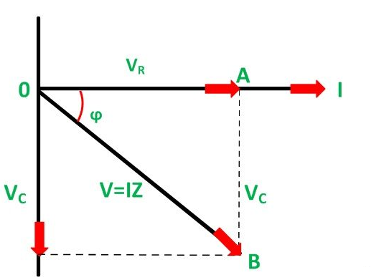
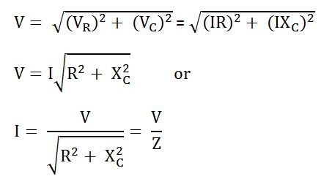

Phasor Diagram of Series RC Circuit
From the phasor diagram we can write
………….(1)
…………………………….(2)
…………………….……….(3)
Fig.4 Phasor dig. of Series RC circuit
………………………….…….(4)
https://circuitglobe.com/what-is-rc-series-circuit.html

Slide 12
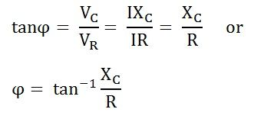
Phasor Diagram of Series RC Circuit
From the phasor diagram we can write phase angle.
…………………(1)
…………………………………(2)
Power Factor of the circuit will be
Contd. As Fig.4 Phasor dig. of Series RC circuit
https://circuitglobe.com/what-is-rc-series-circuit.html

Slide 13
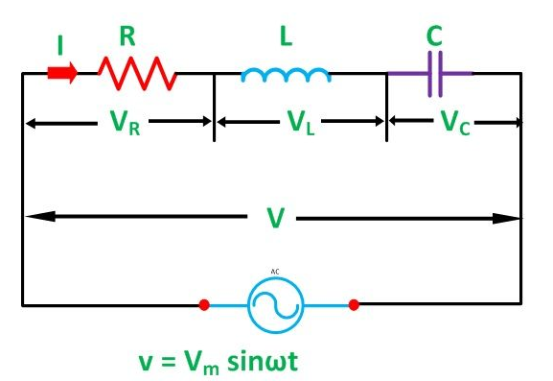
Series RLC Circuit
In Series RLC Circuit, resistor, inductor and capacitor are connected in series, so current flowing through both the elements is same
i.e I_{R} = I_{C}= I_{L}= I.
We are using ac voltage V = Vm sinωt
V_{R} – voltage across the resistor R
V_{L} – voltage across the inductance L
V_{C} – voltage across the capacitance C
V – Total voltage of the circuit
Fig.5 Series RLC circuit
https://circuitglobe.com/what-is-rlc-series-circuit.html

Slide 14
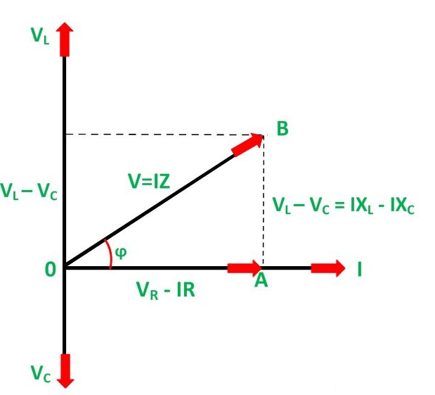
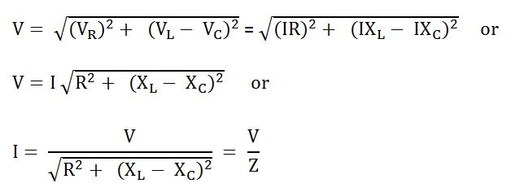

Phasor Diagram of Series RLC Circuit
From the phasor diagram we can write
…..(1)
………………………….…..(2)
………………………….…..(3)
…………………………...(4)
Fig.6 Phasor dig. of series RLC circuit
https://circuitglobe.com/what-is-rc-series-circuit.html

Slide 15
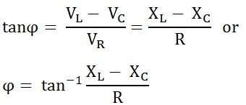

Phasor Diagram of Series RLC Circuit
From the phasor diagram we can write phase angle such as
…………(1)
………………….……(2)
Power factor of the circuit
Fig. 7 Phasor dig. of series RLC circuit
https://circuitglobe.com/what-is-rc-series-circuit.html

Slide 16
Summary
Analysis of Series RL Circuit.
Derivation of phasor of series RL circuit.
Analysis of Series RC Circuit.
Derivation of phasor of series RC circuit.
Analysis of Series RLC Circuit.
Derivation of phasor of series RLC circuit.

Slide 17
Frequently Asked Questions
Q1. In a series R-L circuit, V_{L} ……...V_{R} by………degrees.
A. leads, 90
B. lags, 90
C. leads, 45
D. lags,45
Q2. Voltage applied across R-L circuit is equal to ………………of V_{R} and V_{L}.
A. Arithmetic Sum
B. Algebraic Sum
C. Phasor Sum
D. Sum of the squares

Slide 18
Frequently Asked Questions
Q3. Power factor of an AC circuit is
0
1
Between 0 and 1
Between 0 and -1
Q4. A capacitor having a capacitance of 20 µF is connected in series with a non-inductive resistance 120 Ω across a 100 volt, 50 Hz supply. Calculate:
Phase difference between supply voltage and current.
Power

Slide 19

LEARNING OUTCOMES
To make students understand
Concepts of series RL circuit with its phasor diagram.
Concepts of series RC circuit with its phasor diagram.
Fundamentals of series RLC circuit with its phasor diagram.

Slide 20
Course Outcome to Program Outcome Relationship
 |  | (21ELH-101) BEEE
PO→
CO↓ | PO1 | PO2 | PO3 | PO4 | PO5 | PO6 | PO7 | PO8 | PO9 | PO10 | PO11 | PO12 | PSO1 | PSO2 | PSO3
CO1 | 3 | 2 |  |  |  |  |  |  |  |  |  |  | 3
CO2 | 3 | 2 |  |  |  |  |  |  |  |  |  |  | 3
CO3 | 3 | 2 |  |  |  |  |  |  |  |  |  |  | 3
CO4 | 3 | 2 |  |  |  |  |  |  |  |  |  |  | 3
CO5 | 3 | 2 |  |  |  |  |  |  |  |  |  |  | 3

Slide 21
Assessment Pattern
A Assignment (each assignment) | B Time Bound Surprise Test (each test) | C Quiz (each quiz) | D Mid Semester Test(one per test) | E Homework | F Discussion Forums | G Attendance and engagement Score on BB
10 | 12 | 4 | 20 | NA | NA | 2

Slide 22
References
Books:
Bhattacharya,S.K (2011).Basic Electrical and Electronics Engineering. Pearson
Nagrath(2001).Basic Electrical Engineering. McGraw-Hill Education(India) Pvt. Ltd.
Weblinks:
https://www.electrical4u.com/rl-series-circuit/
https://www.allaboutcircuits.com/textbook/alternating-current/chpt-4/series-resistor-capacitor-circuits/
https://www.electronics-tutorials.ws/accircuits/ac-capacitance.html

Slide 23
THANK YOU
For queries
Email: akhilnigam.eee@cumail.in

